Slide 1
FINAL CAPSTONE WEEK2
FINDING HOTELS IN THE MOST DENSE PLACE
Kim, Jaekyeong

Slide 2
Table of Contents
Introduction : Business Problem
Data
Methodology
Analysis
Results and Discussion
Conclusion

Slide 3
Introduction : Business Problem
-Find an optimal location for hotels -This project is targeting foreigners who visit Korea for purposes whether traveling or on their business -We are trying to make Hotels in Seoul -Looking for the optimal location for our Dense base

Slide 4
Data
- number and location of hotel clusters near Seoul
- How dense of clusters from Seoul
- number of hotels in the clusters
Get Data from Google Maps API & Foursquare API

Slide 5
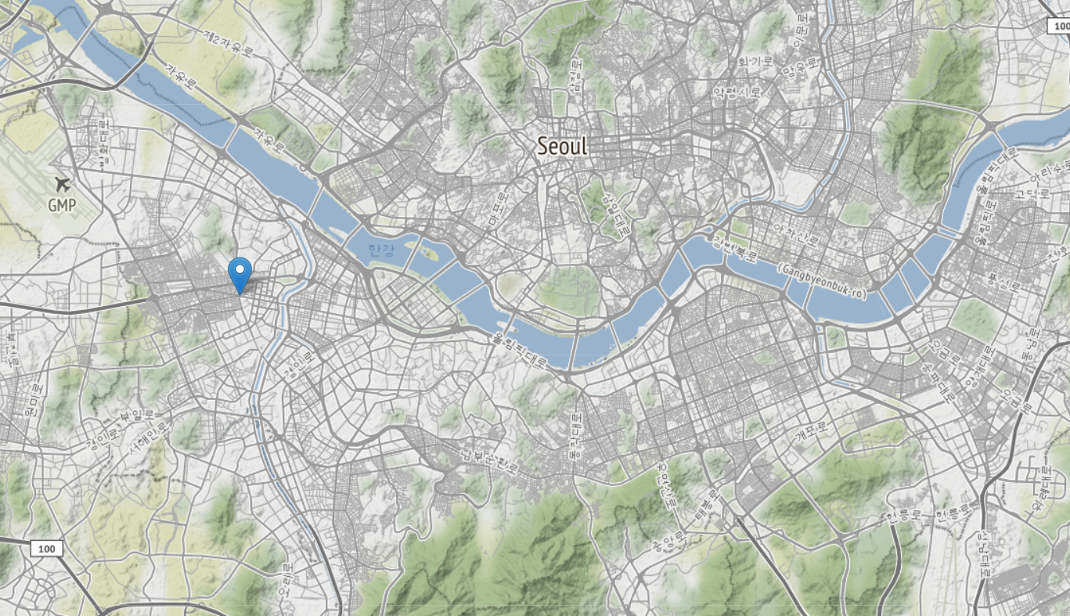
Data
Get Seoul location Data from Google Maps API

Slide 6
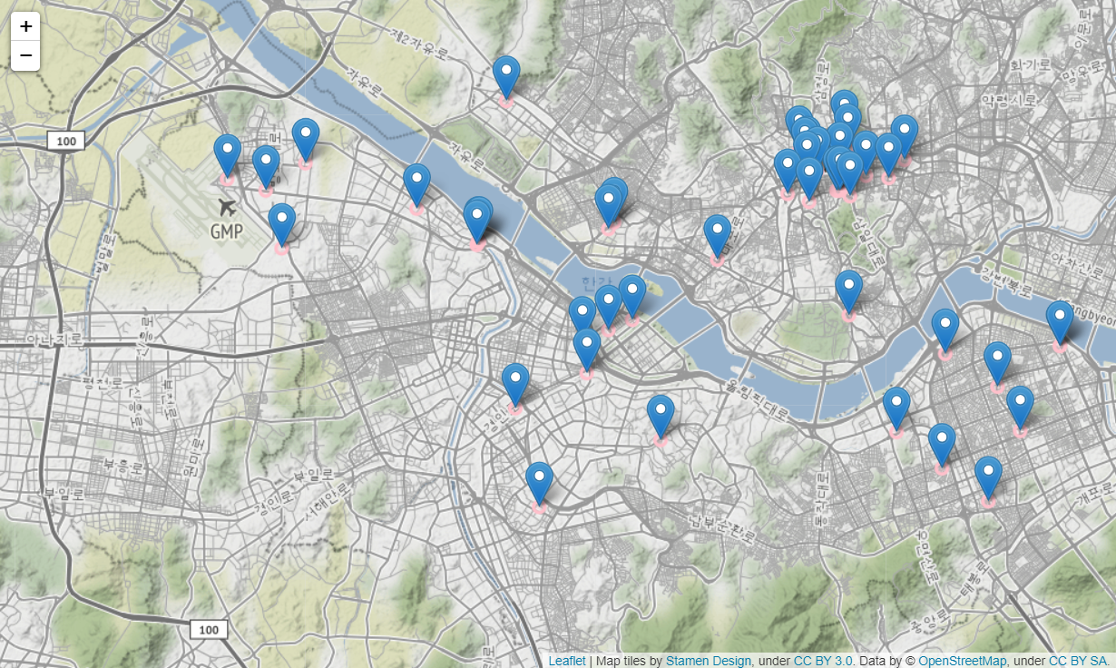
Data
Get Hotel Location Data in Seoul from Foursquare API

Slide 7
Methodology
1. We will use k-means to find clusters of hotels
2. Using visualization optimize clustering.
4. find center location of the clusters and number of hotels in the clusters
5. select important clusters
6. find best location for hotels based on the density from the clusters.

Slide 8
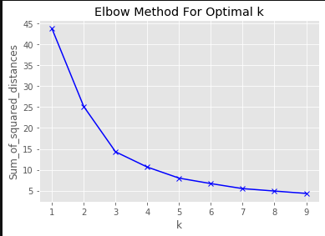
Analysis : K-Means
Use Elbow Method for Optimal k. From this we can find the best k is 5.

Slide 9
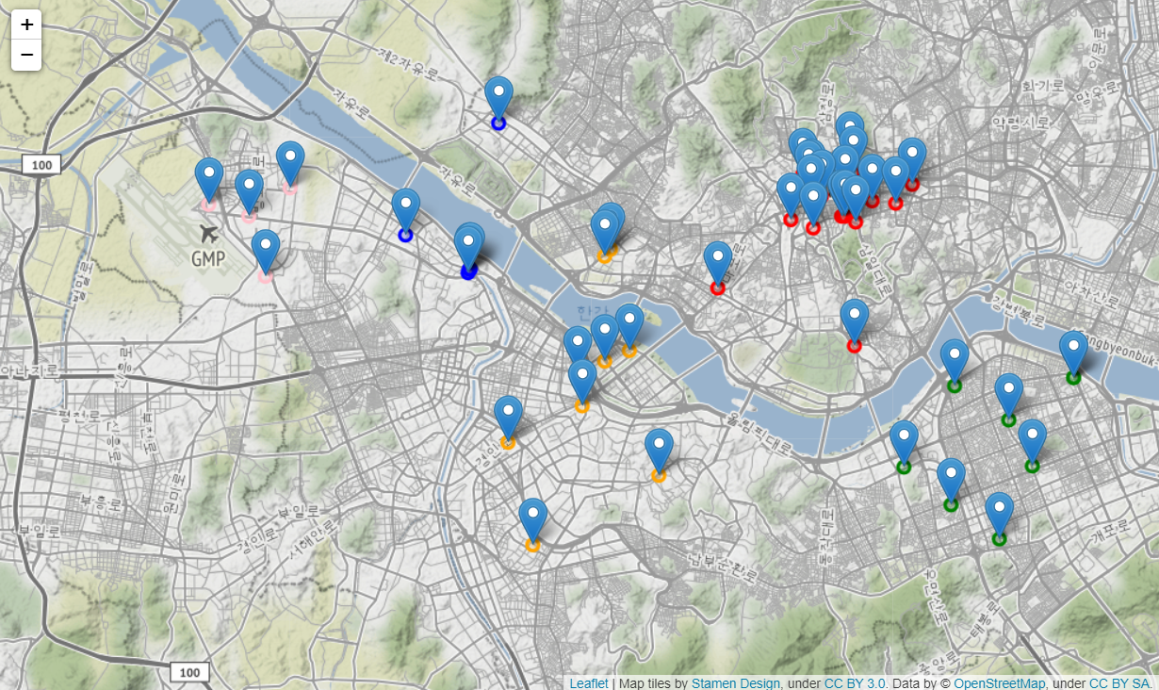
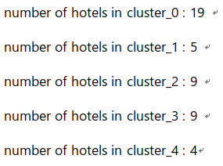
Analysis : K-Means
Draw clusters on the map and check the number of hotels in each clusters.

Slide 10
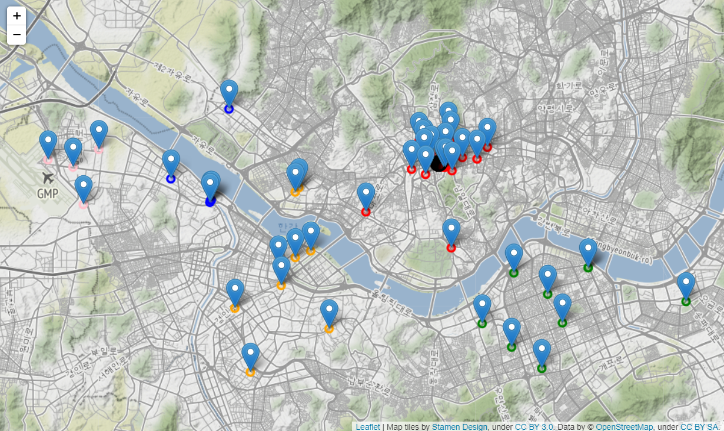
Analysis : K-Means
From the location data of each clusters, we can get center of the clusters. And it is what I find that is the most dense place of hotels.

Slide 11
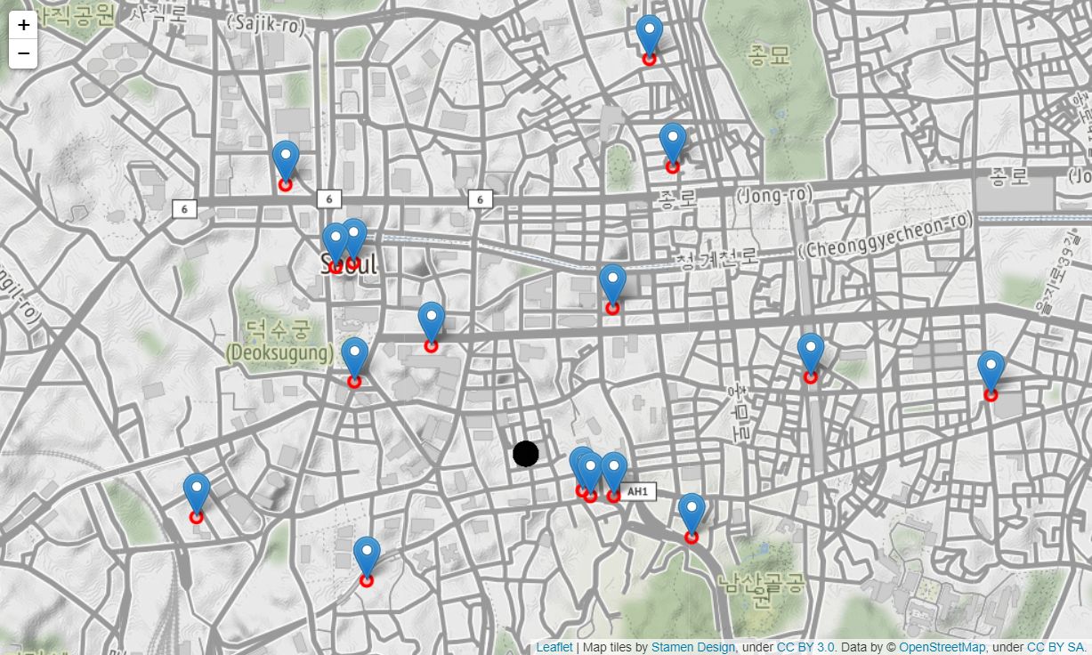
Results and Discussion
From k-means : [37.562406, 126.984639]

